Slide 1
Introduction to Cloud
Cloud computing in Data Analytics

Slide 2
Topics Covered
What is Cloud Computing?
Types of Cloud Computing
Advantages of Cloud Platforms
Cloud Services for Data Analytics, Data Science and AI
Data Analytics and Data Sciences Pipelines
GCP overview
AWS overview
Azure overview
AWS vs Azure vs GCP services

Slide 3
What is Cloud Computing?
The Cloud, or Cloud Computing, refers to the delivery of pay-as-you-go computing services hosted on an internet-based infrastructure. These services include storage, databases, networking, software, analytics, and intelligent solutions.
Cloud computing plays a crucial role in data analytics. It provides the necessary infrastructure and resources to efficiently process and analyze large volumes of data.
Notes:
Cloud providers provide cloud computing services for anyone on demand.
Not all the companies can afford having a datacenter, pay maintenance, power management, cooling, and upgrades
Ability to acquire resources as you need them and release resources when you no longer need them.
Pay as you go

Slide 4
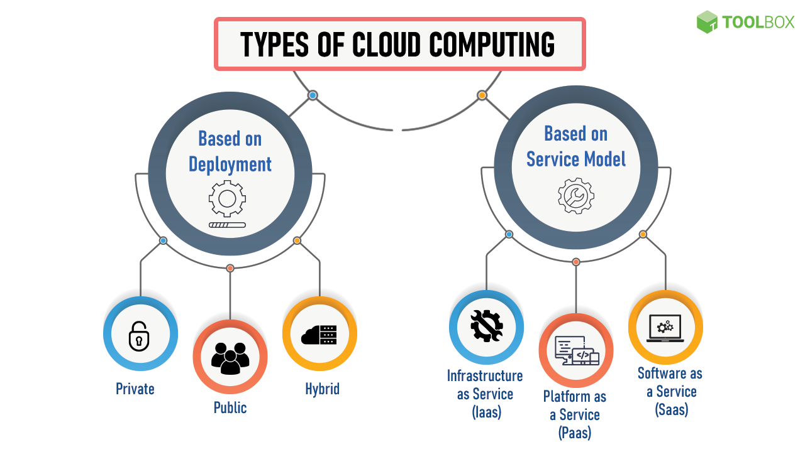
Types of Cloud Computing

Slide 5
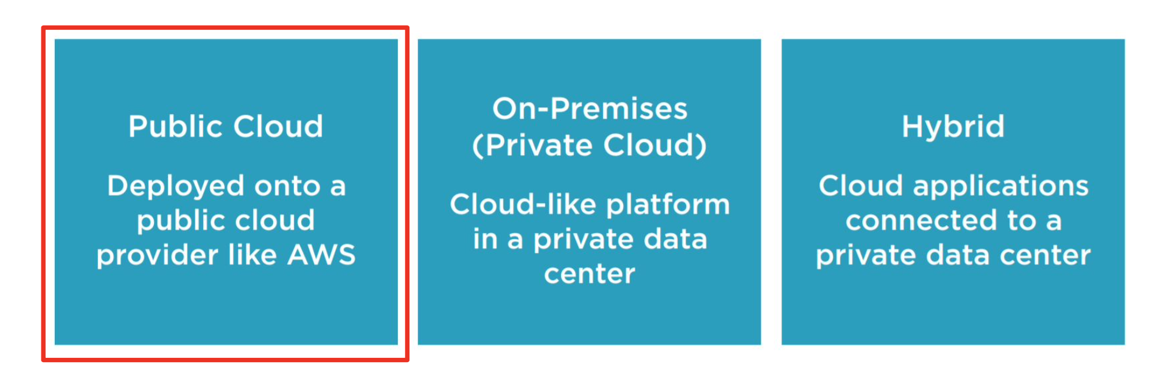
Types of Cloud Computing
Based on Deployment

Slide 6
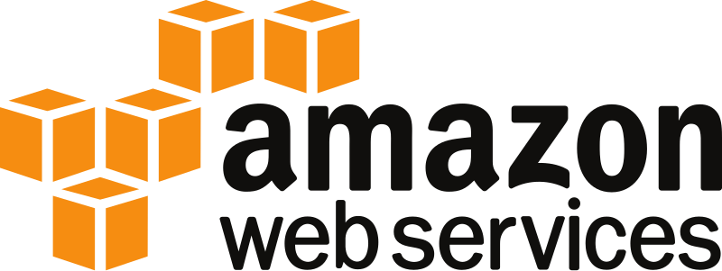


Main cloud computing providers
Each provider has their own certification exams

Slide 7
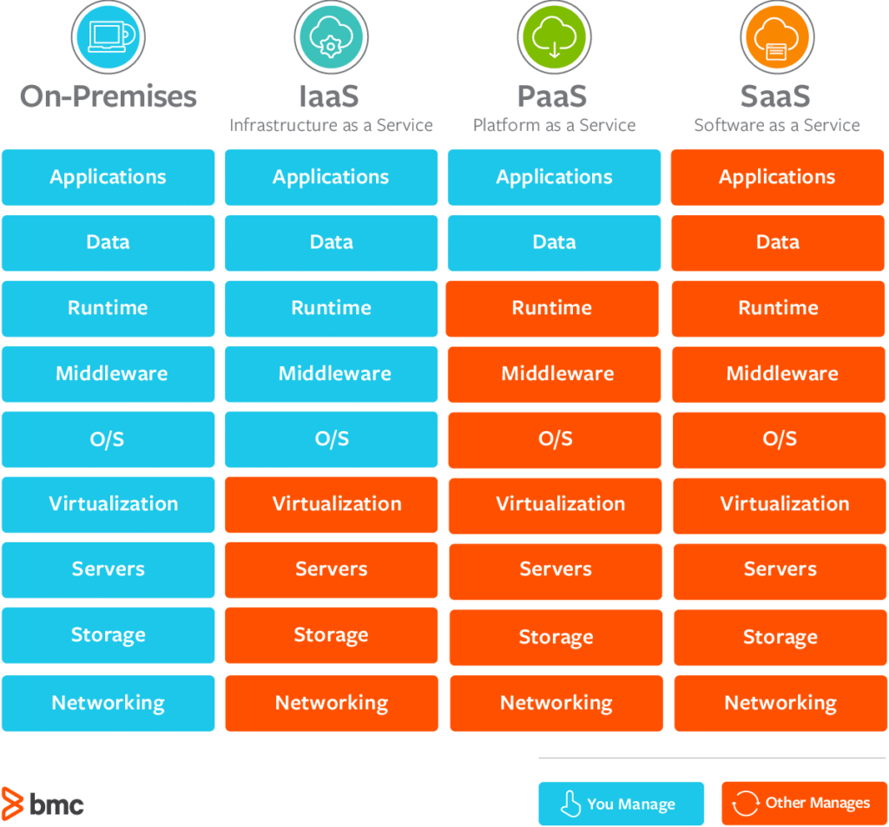
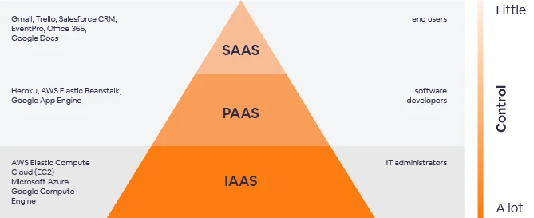
Types of Cloud Computing
Based on Service Model

Slide 8
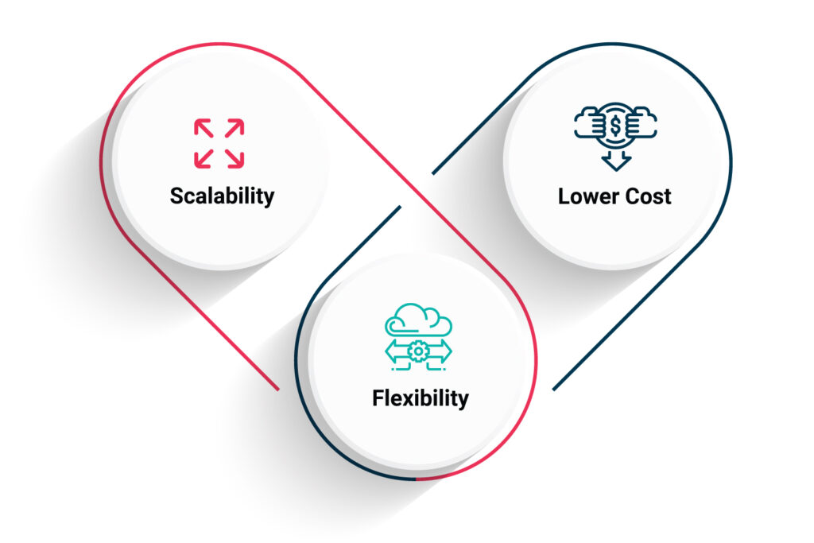
Advantages of Cloud Platforms
Scalability: Easily scale computing resources up or down based on data processing needs.
Cost-effectiveness: Pay for resources and services used, reducing upfront infrastructure costs.
Flexibility: Access data and analytics tools from anywhere, at any time, using any device.
And more: Rapid Deployment, Advanced Analytics Capabilities, Data Security and Backup, Collaboration…

Slide 9
Cloud Services
Data Analytics Services
Data storage and management
Data preprocessing and transformation
Data warehousing
Data querying
Visualization and reporting
Data Science Services
Data preprocessing
Model training
Model deployment
Collaboration tools
Access to advanced machine learning algorithms and libraries
AI services, including:
Pre-trained models
APIs for image recognition, natural language processing, and sentiment analysis

Slide 10
How to Build a Scalable Data Analytics Pipeline
A data analytics pipeline is a process collection that transforms raw data into useful solutions to business issues. Pipelines for data analytics streamline data movement from source to destination, allowing you to make better business decisions.
These concepts are applicable in any other cloud or on-premise data pipeline.

Slide 11
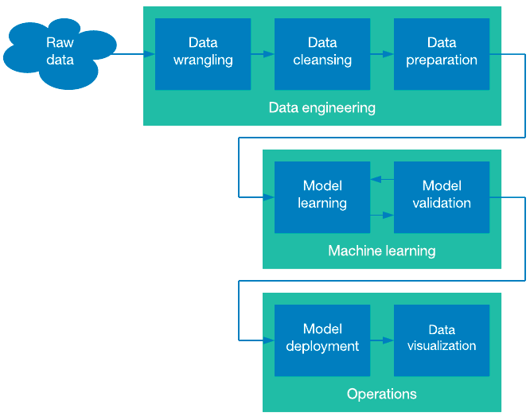
How to Build a Scalable Data Science Pipeline

Slide 12
GCP (Google Cloud Platform)

Slide 13
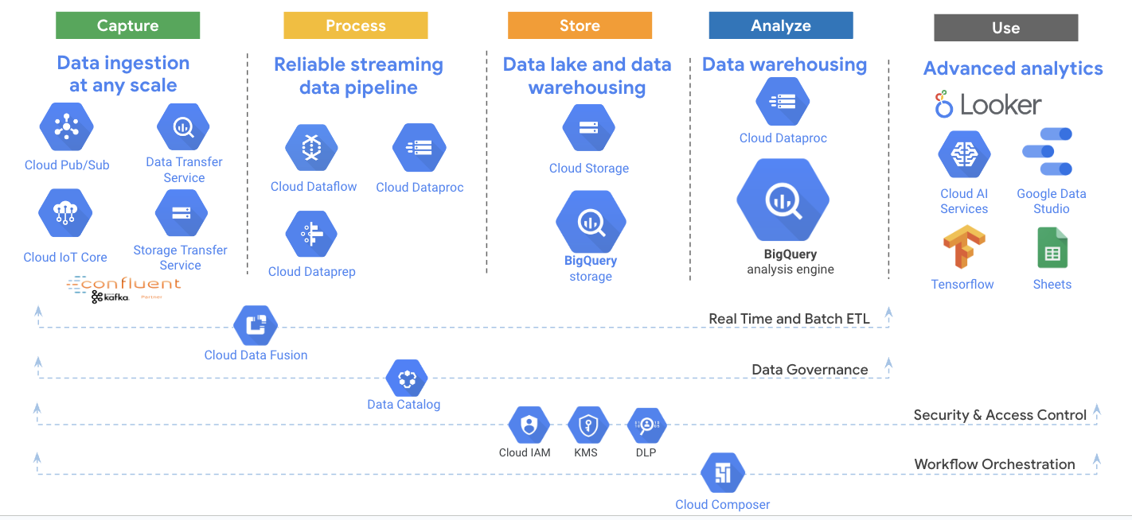
A comprehensive and serverless platform across the data lifecycle

Slide 14
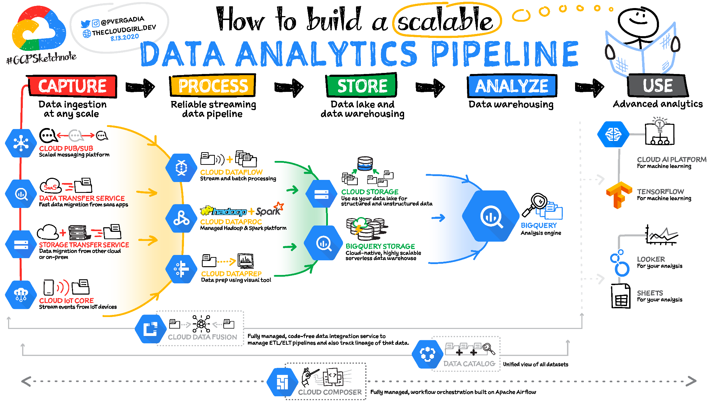

Slide 15
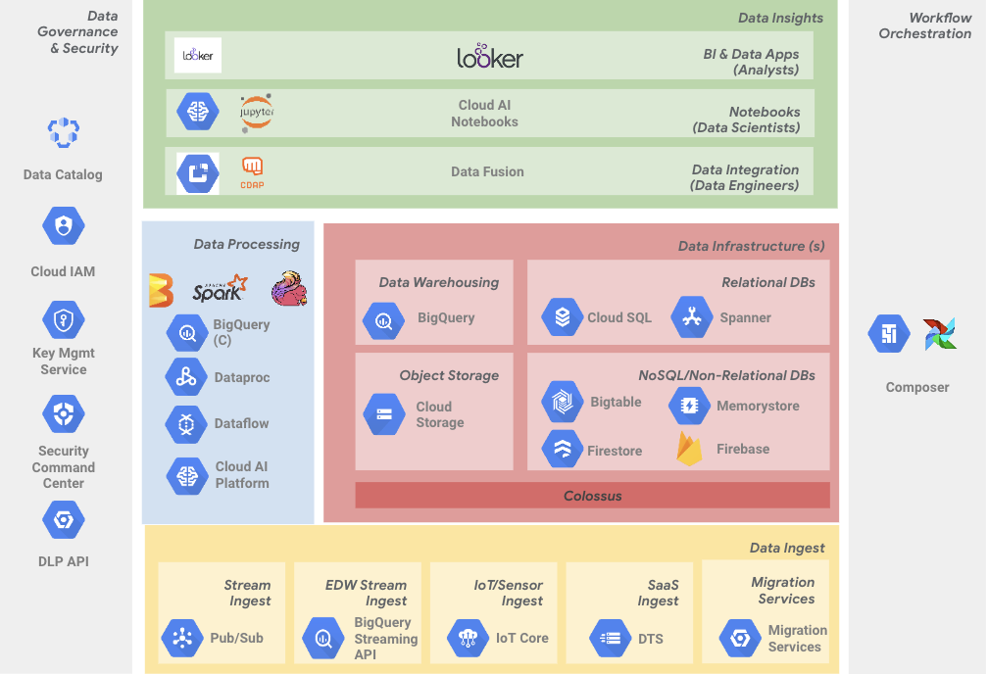
Google Cloud data management and analytics

Slide 16


Built-in intelligence
BigQuery ML - build custom models with standard SQL
Google Cloud provides extensive integrated AI and ML services for data analytics including; BigQuery ML, Auto ML, Cloud ML Engine, Tensorflow and more.
1
Execute ML initiatives without moving data from BigQuery
2
Iterate on models in SQL in BigQuery to increase development speed
3
Automate common ML tasks, and hyperparameter tuning
1
2
3

Slide 17
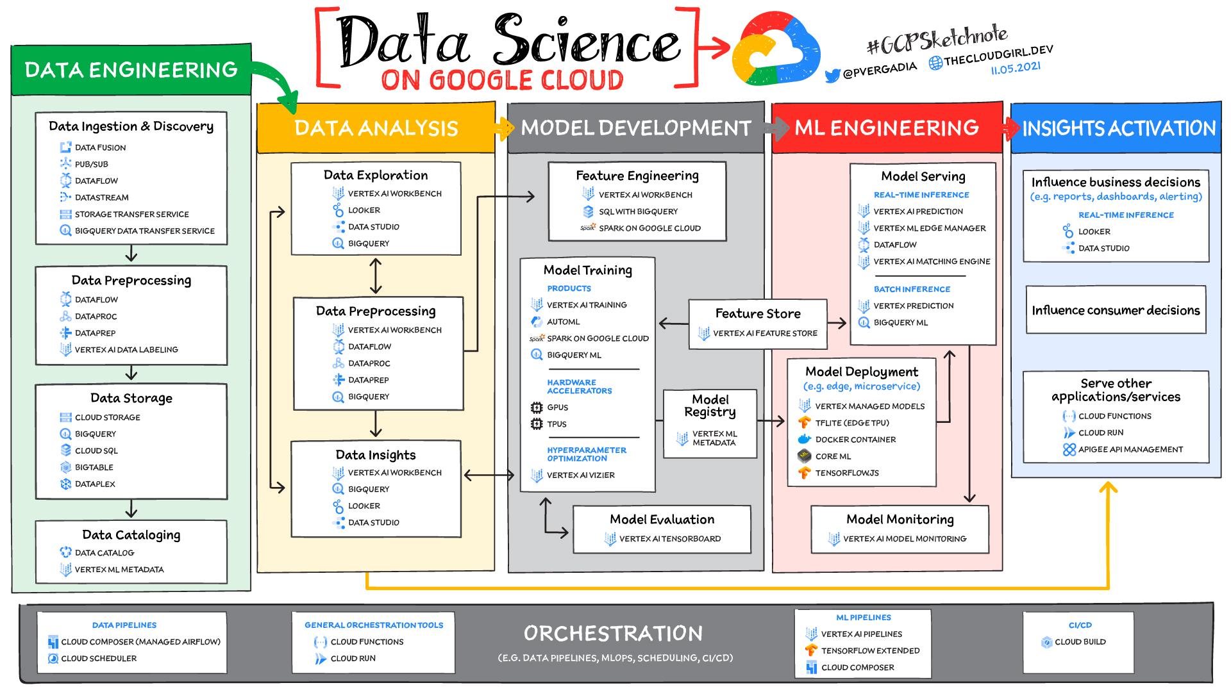

Slide 18
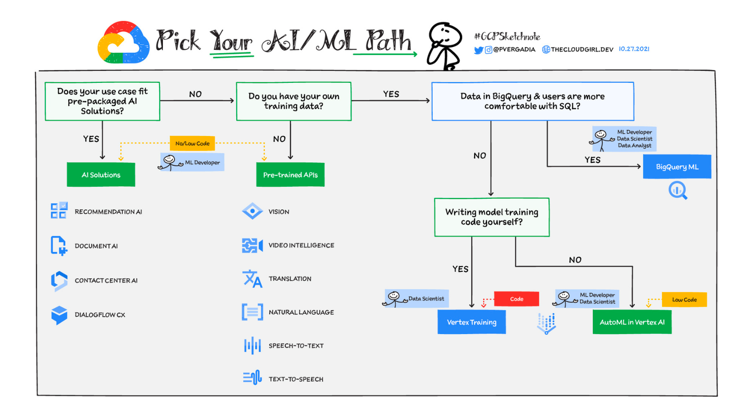
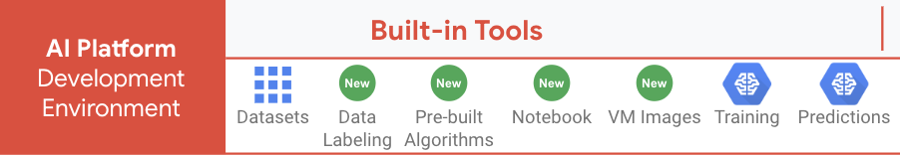

Slide 19
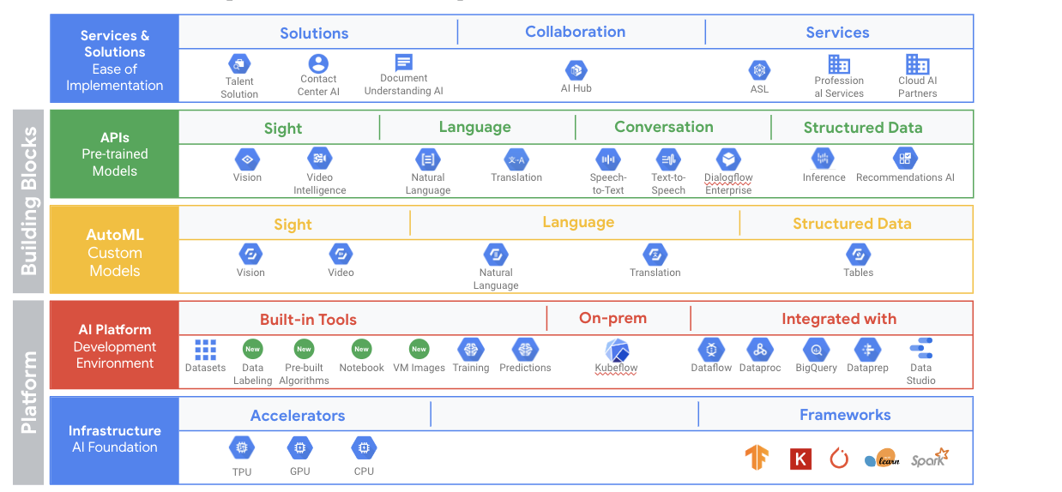
AI for every level of expertise

Slide 20
AWS (Amazon Web Services)

Slide 21
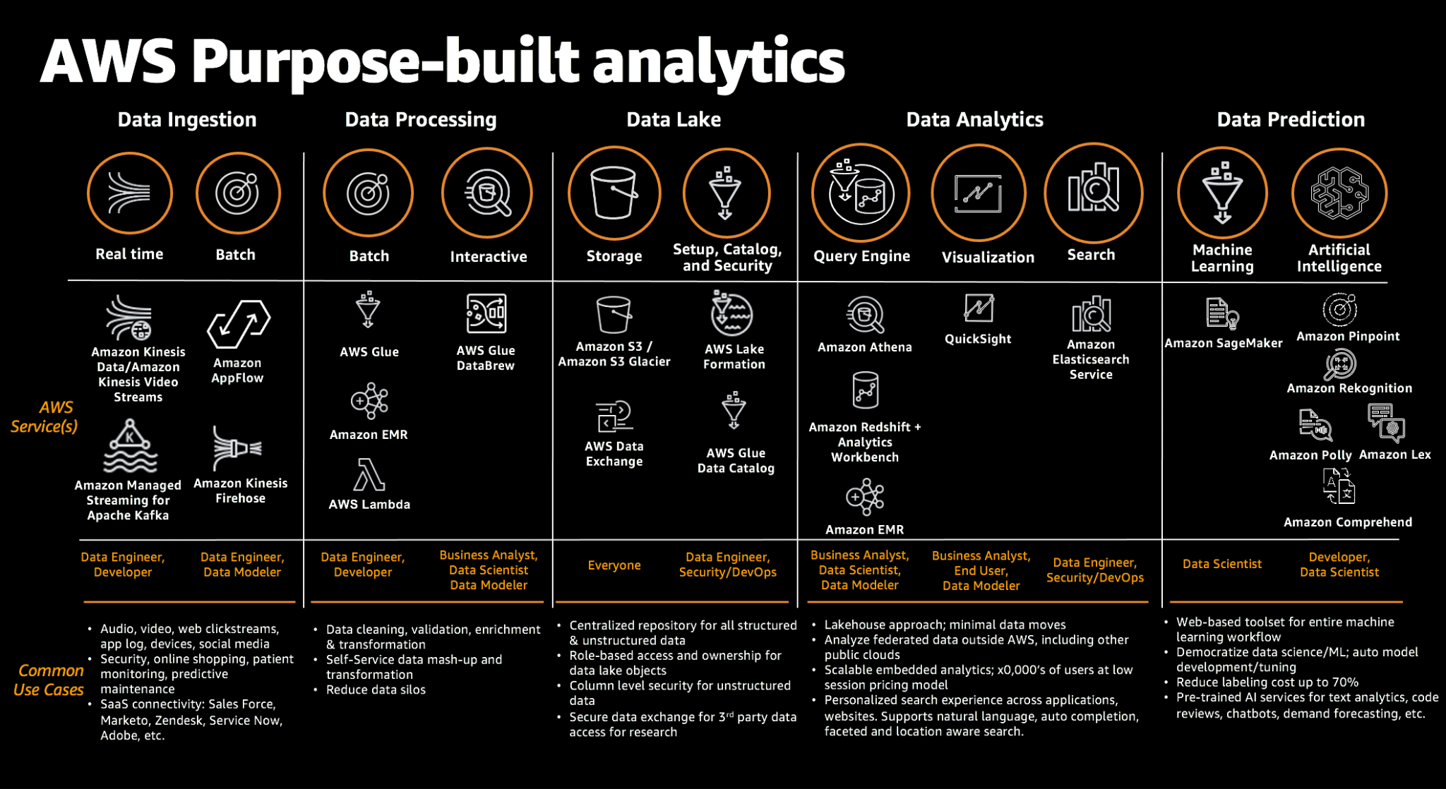
AWS services for Data Analytics

Slide 22
Microsoft Azure

Slide 23
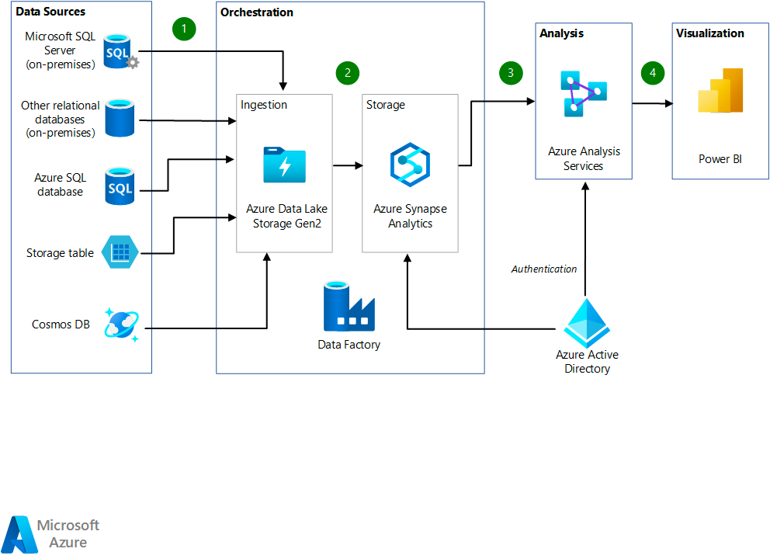
Data Analytics Architecture
You can find different proposed architectures for different business cases

Slide 24
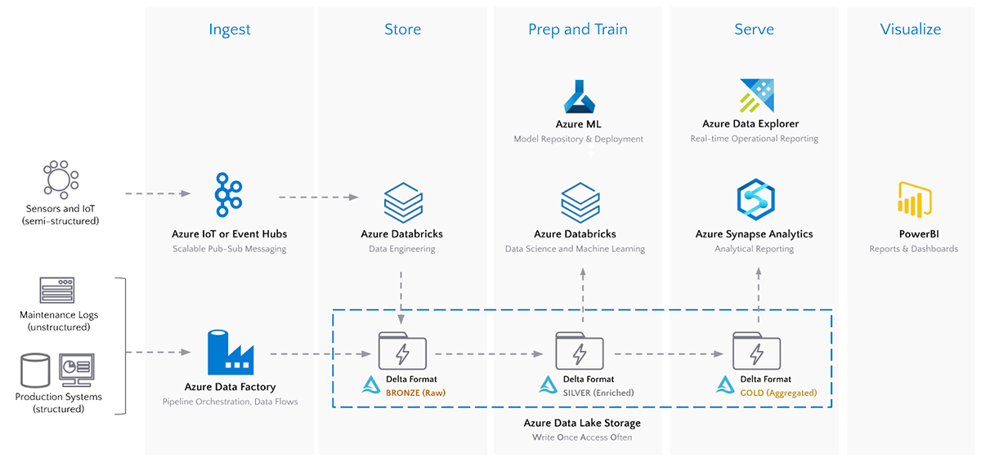
Data Science Architecture
You can find different proposed architectures for different business cases

Slide 25
AWS vs Azure vs GCP services

Slide 26
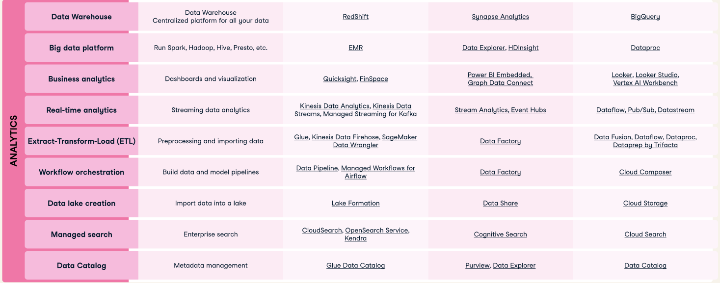
Link to the source: cheat sheet that compares Cloud Services across the three major platforms.

Slide 27
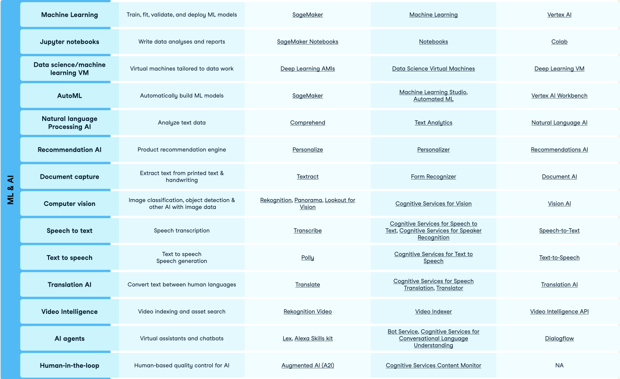
Link to the source: cheat sheet that compares Cloud Services across the three major platforms.

Slide 28
AWS in depth

Slide 29
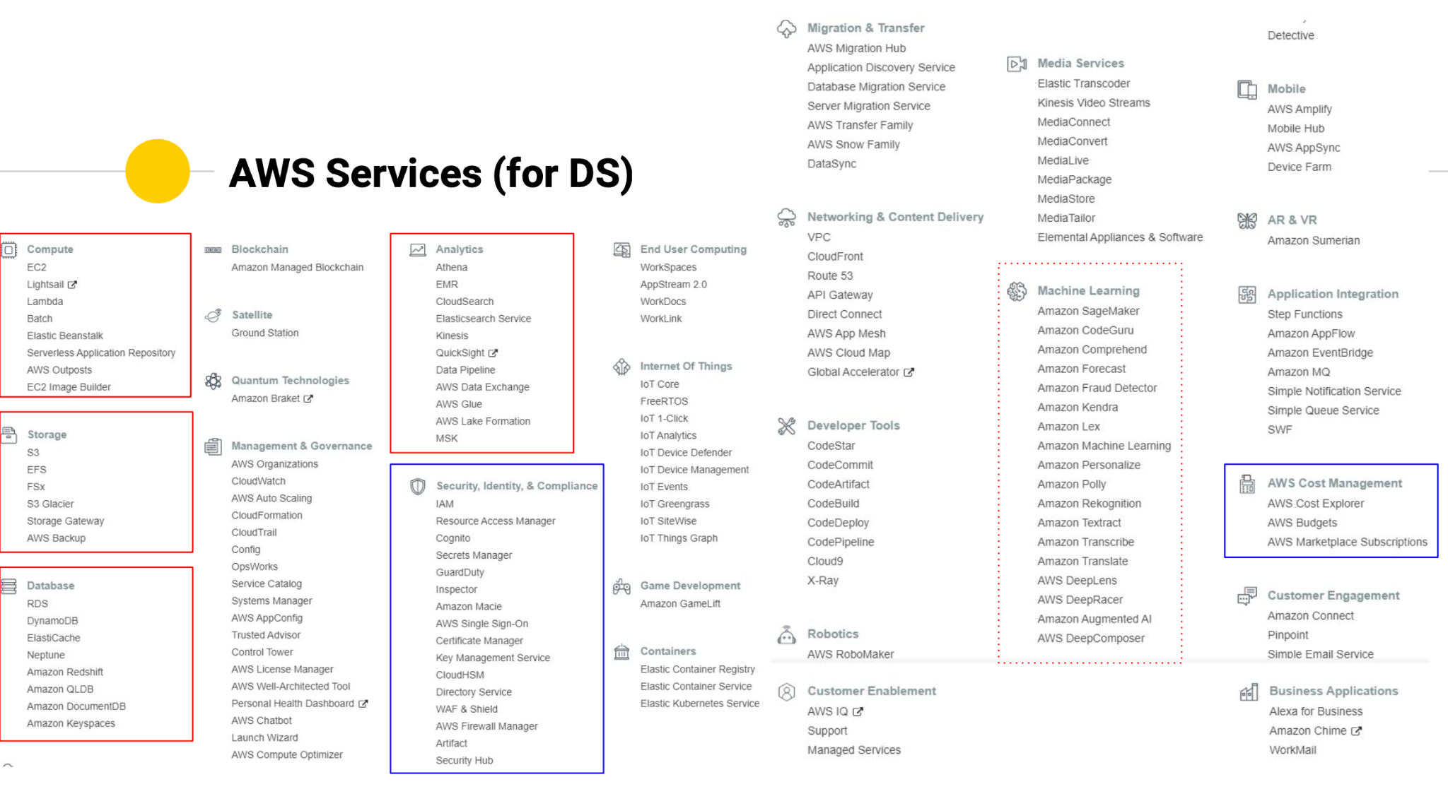
Notes:
AWS has around 250 different services for different purposes and growing!

Slide 30

Storage service: S3
Is a very cheap service to store information organized in buckets.
Every bucket is tied to an specific region. It can’t be seen from instances in other regions.
Encryption can be enabled for the files stored
Bucket name should be globally unique.
Data transfer between regions is charged. The user can enable cross region replication.
There are different types of buckets:
Standard
Infrequent access (IA)
Intelligent tier (IT)
One infrequent access (IA)
Glacier
Glacier Deep Archive
Notes:
User can enable:
Permissions
Versioning ( not git, internal )
Lifecycle ( change the type of bucket according to a time interval )

Slide 31

Virtual machine service: EC2
The service to rent computers is called EC2.
EC2 service has many different types of computers called “instances” grouped in families and subfamilies:
Family ( T, C, G,....)
Subfamily. ( T2.micro, T2.medium…)
Instance types official documentation
Every instance comes with it’s own hard drive, but it is ‘volatile’. (disappears when the machine is terminated)
Notes:
By default every instance come with a user and credentials.
Additional access is controlled by means of “security groups”.
“Security groups” controls inbound and outbound traffic to the instance.
By default Outbound traffic is allowed.
Inbound traffic is blocked except some services and ports.
“Security groups” can control access at IP level.
Every instance has a public IP and a internal IP
There are four delivery options that can affect the final price:
On demand: the instance is provided to the customer within seconds. (price per second after 1min)
Spot: bidding service for instance resource ( the user specifies a threshold price to pay and the instance runs whenever the price is lower than the threshold, but it’s terminated when the price is higher than the threshold losing everything)
Reserved instances: instances permanently available for:
1 year
3 years
Standard instances
Convertible instances
Scheduled instances
Payment options:
Upfront
50% upfront, 50% end of service
End of service
Dedicated instances
Dedicated hosts

Slide 32

Sagemaker
This is a self managed service which uses jupyter notebooks to:
Label data
Explore data
Train models
Deploy models in production
It allows to carry out all the previous steps all in one or individually
It has GitHub integration
Integrates with S3 service
It has his own library covering many ML models
It has access to boto3 ( AWS SDK )

Slide 33
Sagemaker
What it does and how?
Official documentation
It comes with many libraries already installed and different types of “Kernels” with additional libraries already installed.
To train a model you can use:
Sklearn
Keras
….
Sagemaker library
Sagemaker studio uses particular types of instances for ML (not the regular ones)
It needs to have the data stored into an S3 bucket
It perform hyperparameter optimization on separate “training instances” and returns the output into another S3 bucket
Allow to “deploy” your model into another “inference instance”

Slide 34
Billing
You will be charged at the end of the month by every payware service used during the month. No use, no charge
The bill summary is updated on a daily basis

